Slide 1

APEX INSTITUTE OF TECHNOLOGY
DEPARTMENT OF COMPUTER SCIENCE & ENGINEERING
Computer Organization & Architecture (21CSH-281)
Faculty: Siddharth Kumar (E12853)
Lecture – 16 & 17
CPU Control Unit Design: Hardwired Design & Micro-programmed Design Approach
DISCOVER . LEARN . EMPOWER

Slide 2
Computer Organization & Architecture: Course Objectives
COURSE OBJECTIVES
The course aims to:
The purpose of the course is to introduce principles of computer organization and the basic architectural concepts.
It begins with basic organization, design, and programming of a simple digital computer and introduces simple register transfer language to specify various computer operations.
Topics include computer arithmetic, instruction set design, microprogrammed control unit, pipelining and vector processing, memory organization and I/O systems, and multiprocessors.
To familiarize Students with the detailed Architectures of a Central Processing Unit.
Learn the different types of serial communication techniques.

Slide 3
COURSE OUTCOMES
On completion of this course, the students shall be able to:-
CO1 | Identify and interpret the basics of instruction sets and their impact on the design, organization, and functionality of various functional units of a computer comparable to the CPU, memory organization, I/O organization, and parallel processors.
CO2 | Analysis of the design of arithmetic & logic unit and understanding of the fixed point and floating-point arithmetic operations.
CO3 | Relate cost performance and design trade-offs in designing and constructing a computer processor which includes memory.
CO4 | Understanding the different ways of communicating with I/O devices and standard I/O interfaces.
CO5 | Implementation of control unit techniques and the concept of Pipelining.

Slide 4
What is CPU Control unit design?
Control unit is the part of the computer’s Central Processing Unit (CPU), which directs the operation of the processor. It was included as part of the Von Neumann Architecture by John von Neumann. It is the responsibility of the Control Unit to tell the computer’s memory, arithmetic/logic unit and input and output devices how to respond to the instructions that have been sent to the processor. It fetches internal instructions of the programs from the main memory to the processor instruction register, and based on this register contents, the control unit generates a control signal that supervises the execution of these instructions.
A control unit works by receiving input information to which it converts into control signals, which are then sent to the central processor. The computer’s processor then tells the attached hardware what operations to perform. The functions that a control unit performs are dependent on the type of CPU because the architecture of CPU varies from manufacturer to manufacturer. Examples of devices that require a CU are:
Control Processing Units(CPUs)
Graphics Processing Units(GPUs)

Slide 5
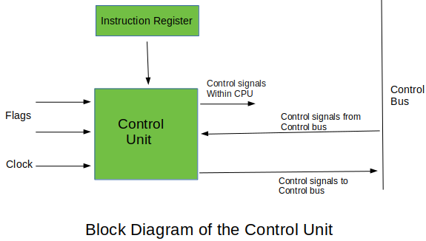

Slide 6
Functions of the Control Unit
It coordinates the sequence of data movements into, out of, and between a processor’s many sub-units.
It interprets instructions.
It controls data flow inside the processor.
It receives external instructions or commands to which it converts to sequence of control signals.
It controls many execution units(i.e. ALU, data buffers and registers) contained within a CPU.
It also handles multiple tasks, such as fetching, decoding, execution handling and storing results.
Types of Control Unit
There are two types of control units:
Hardwired control unit and
Micro-programmable control unit.

Slide 7
Hardwired Control Unit
In the Hardwired control unit, the control signals that are important for instruction execution control are generated by specially designed hardware logical circuits, in which we can not modify the signal generation method without physical change of the circuit structure.
The operation code of an instruction contains the basic data for control signal generation. In the instruction decoder, the operation code is decoded. The instruction decoder constitutes a set of many decoders that decode different fields of the instruction opcode.
As a result, few output lines going out from the instruction decoder obtains active signal values. These output lines are connected to the inputs of the matrix that generates control signals for executive units of the computer.
This matrix implements logical combinations of the decoded signals from the instruction opcode with the outputs from the matrix that generates signals representing consecutive control unit states and with signals coming from the outside of the processor, e.g. interrupt signals. The matrices are built in a similar way as a programmable logic arrays.

Slide 8
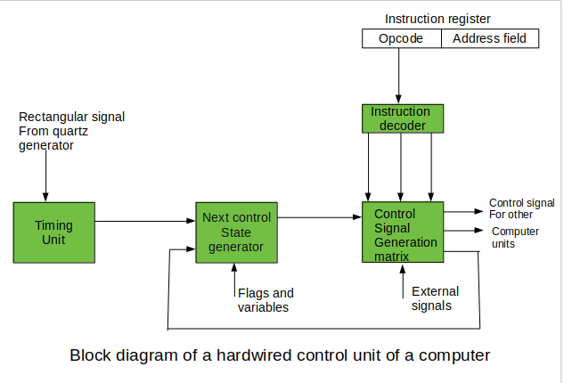

Slide 9
Control signals for an instruction execution have to be generated not in a single time point but during the entire time interval that corresponds to the instruction execution cycle.
Following the structure of this cycle, the suitable sequence of internal states is organized in the control unit.
A number of signals generated by the control signal generator matrix are sent back to inputs of the next control state generator matrix.
This matrix combines these signals with the timing signals, which are generated by the timing unit based on the rectangular patterns usually supplied by the quartz generator.
When a new instruction arrives at the control unit, the control units is in the initial state of new instruction fetching. Instruction decoding allows the control unit enters the first state relating execution of the new instruction, which lasts as long as the timing signals and other input signals as flags and state information of the computer remain unaltered.
A change of any of the earlier mentioned signals stimulates the change of the control unit state.

Slide 10
This causes that a new respective input is generated for the control signal generator matrix.
When an external signal appears, (e.g. an interrupt) the control unit takes entry into a next control state that is the state concerned with the reaction to this external signal (e.g. interrupt processing).
The values of flags and state variables of the computer are used to select suitable states for the instruction execution cycle.
The last states in the cycle are control states that commence fetching the next instruction of the program: sending the program counter content to the main memory address buffer register and next, reading the instruction word to the instruction register of computer.
When the ongoing instruction is the stop instruction that ends program execution, the control unit enters an operating system state, in which it waits for a next user directive.

Slide 11
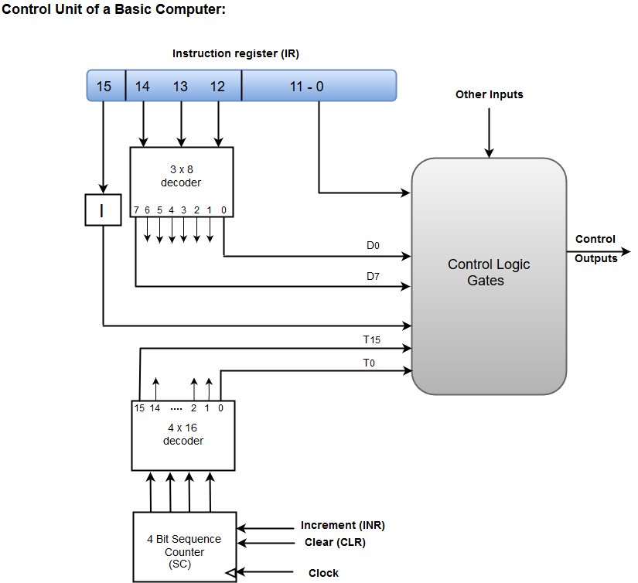

Slide 12
A Hard-wired Control consists of two decoders, a sequence counter, and a number of logic gates.
An instruction fetched from the memory unit is placed in the instruction register (IR).
The component of an instruction register includes; I bit, the operation code, and bits 0 through 11.
The operation code in bits 12 through 14 are coded with a 3 x 8 decoder.
The outputs of the decoder are designated by the symbols D0 through D7.
The operation code at bit 15 is transferred to a flip-flop designated by the symbol I.
The operation codes from Bits 0 through 11 are applied to the control logic gates.
The Sequence counter (SC) can count in binary from 0 through 15.

Slide 13
Micro-programmable Control Unit
The fundamental difference between these unit structures and the structure of the hardwired control unit is the existence of the control store that is used for storing words containing encoded control signals mandatory for instruction execution.
In microprogrammed control units, subsequent instruction words are fetched into the instruction register in a normal way. However, the operation code of each instruction is not directly decoded to enable immediate control signal generation but it comprises the initial address of a microprogram contained in the control store.
With a single-level control store
In this, the instruction opcode from the instruction register is sent to the control store address register. Based on this address, the first microinstruction of a microprogram that interprets execution of this instruction is read to the microinstruction register. This microinstruction contains in its operation part encoded control signals, normally as few bit fields. In a set microinstruction field decoders, the fields are decoded. The microinstruction also contains the address of the next microinstruction of the given instruction microprogram and a control field used to control activities of the microinstruction address generator.

Slide 14
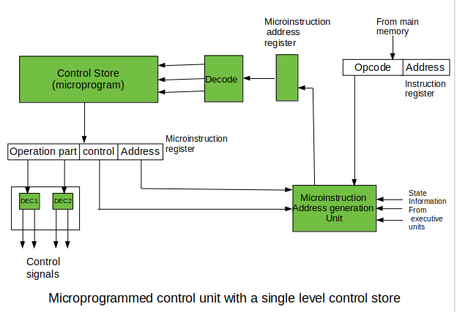

Slide 15
The last mentioned field decides the addressing mode (addressing operation) to be applied to the address embedded in the ongoing microinstruction. In microinstructions along with conditional addressing mode, this address is refined by using the processor condition flags that represent the status of computations in the current program. The last microinstruction in the instruction of the given microprogram is the microinstruction that fetches the next instruction from the main memory to the instruction register.
With a two-level control store:
In this, in a control unit with a two-level control store, besides the control memory for microinstructions, a nano-instruction memory is included. In such a control unit, microinstructions do not contain encoded control signals. The operation part of microinstructions contains the address of the word in the nano-instruction memory, which contains encoded control signals. The nano-instruction memory contains all combinations of control signals that appear in microprograms that interpret the complete instruction set of a given computer, written once in the form of nano-instructions.

Slide 16
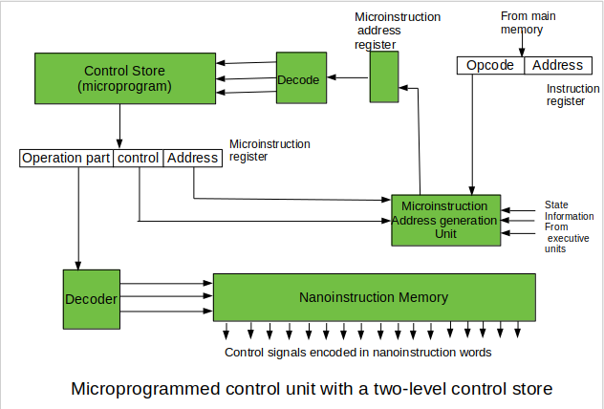

Slide 17
In this way, unnecessary storing of the same operation parts of microinstructions is avoided. In this case, microinstruction word can be much shorter than with the single level control store. It gives a much smaller size in bits of the microinstruction memory and, as a result, a much smaller size of the entire control memory.
The microinstruction memory contains the control for selection of consecutive microinstructions, while those control signals are generated at the basis of nano-instructions. In nano-instructions, control signals are frequently encoded using 1 bit/ 1 signal method that eliminates decoding.
The Microprogrammed Control organization is implemented by using the programming approach.
In Microprogrammed Control, the micro-operations are performed by executing a program consisting of micro-instructions.
The following image shows the block diagram of a Microprogrammed Control organization.

Slide 18
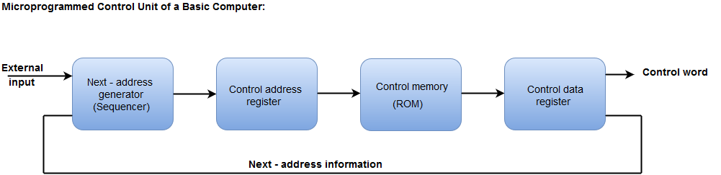
The Control memory address register specifies the address of the micro-instruction.
The Control memory is assumed to be a ROM, within which all control information is permanently stored.
The control register holds the microinstruction fetched from the memory.
The micro-instruction contains a control word that specifies one or more micro-operations for the data processor.
While the micro-operations are being executed, the next address is computed in the next address generator circuit and then transferred into the control address register to read the next microinstruction.
The next address generator is often referred to as a micro-program sequencer, as it determines the address sequence that is read from control memory.

Slide 19
Summary
Discussed about Design of Control Unit.
Discussed about Types of Design of Control Unit.
Discussed about Hardwired Control Unit.
Discussed about Microprogrammed Control.
Assessment Questions
Q1. What are Types of Design of Control Unit?
Q2. What is Microprogrammed Control?

Slide 20
THANK YOU

